Slide 1
W05 – W08 Spark machine learning
2024
The Hoang

Slide 2
Learning Objectives
Learning the Apache Spark ML by Practicing Labs:
Customer Churn Analysis

Slide 3
Apache Spark's Mllib – summary
Recap
Category | Algorithms in Spark MLlib
Supervised Learning | Logistic Regression, Decision Trees, Random Forests, GBT, Linear Regression, Naive Bayes, etc.
Classification | Logistic Regression, Decision Trees, Random Forests, GBT, SVM, Naive Bayes, MLP
Regression | Linear Regression, Decision Trees, Random Forests, GBT, Generalized Linear Models, AFT
Unsupervised Learning | K-means, GMM, Bisecting K-means, LDA, PCA, SVD
Clustering | K-means, GMM, Bisecting K-means, LDA
Dimensionality Reduction | PCA, SVD
Recommendation Systems | ALS (Alternating Least Squares)
Ensemble Methods | Random Forests, Gradient-Boosted Trees
Feature Transformation | StandardScaler, MinMaxScaler, StringIndexer, OneHotEncoder, TF-IDF, Word2Vec, etc.
Evaluation & Tuning | CrossValidator, TrainValidationSplit, BinaryClassificationEvaluator, RegressionEvaluator, etc.

Slide 4
Data preprocessing & cleansing
Importance of Data Preprocessing and Cleansing
Quality of Insights: Clean data leads to more accurate and reliable insights. Poor quality data can skew results and lead to incorrect conclusions.
Model Performance: Machine learning models are sensitive to the quality of the input data. Preprocessing helps improve the model's performance by ensuring that the data is in a suitable format.
Reducing Noise: Data often contains noise (irrelevant or redundant information). Cleaning the data helps to reduce this noise, allowing models to focus on relevant patterns.
Handling Missing Values: Real-world data is often incomplete. Proper handling of missing values prevents biases and inaccuracies in analysis.
Feature Engineering: Preprocessing allows data scientists to create new features that can improve model effectiveness.

Slide 5
Data preprocessing & cleansing
Typical Activities in Data Preprocessing and Cleansing
Data Cleaning:
Removing Duplicates: Identifying and eliminating duplicate records to ensure data integrity.
Handling Missing Values: Strategies include imputation, removal, or using algorithms that can handle missing values.
Filtering Outliers: Identifying and addressing outliers that may skew results.
Data Transformation:
Normalization/Standardization: Scaling numerical features to a common range to improve model training.
Encoding Categorical Variables: Converting categorical data into numerical format using techniques like one-hot encoding or label encoding.
Data Reduction:
Dimensionality Reduction: Techniques like PCA (Principal Component Analysis) to reduce the number of features while retaining essential information.
Sampling: Reducing the size of the dataset by selecting a representative subset.

Slide 6
Data preprocessing & cleansing
Typical Activities in Data Preprocessing and Cleansing
Data Integration:
Merging Datasets: Combining data from different sources to create a unified dataset for analysis.
Resolving Schema Conflicts: Ensuring that data from different sources aligns properly and follows a consistent schema.
Data Formatting:
Date and Time Formatting: Ensuring date and time fields are in a consistent format.
String Manipulation: Cleaning and formatting string data (e.g., trimming whitespace, correcting typos).
Feature Engineering:
Creating New Features: Deriving new variables that can provide additional insights or improve model accuracy.
Binning: Converting continuous variables into categorical ones by grouping them into bins.

Slide 7
Data preprocessing & cleansing
LAB: Preprocessing & Cleansing Data

Slide 8
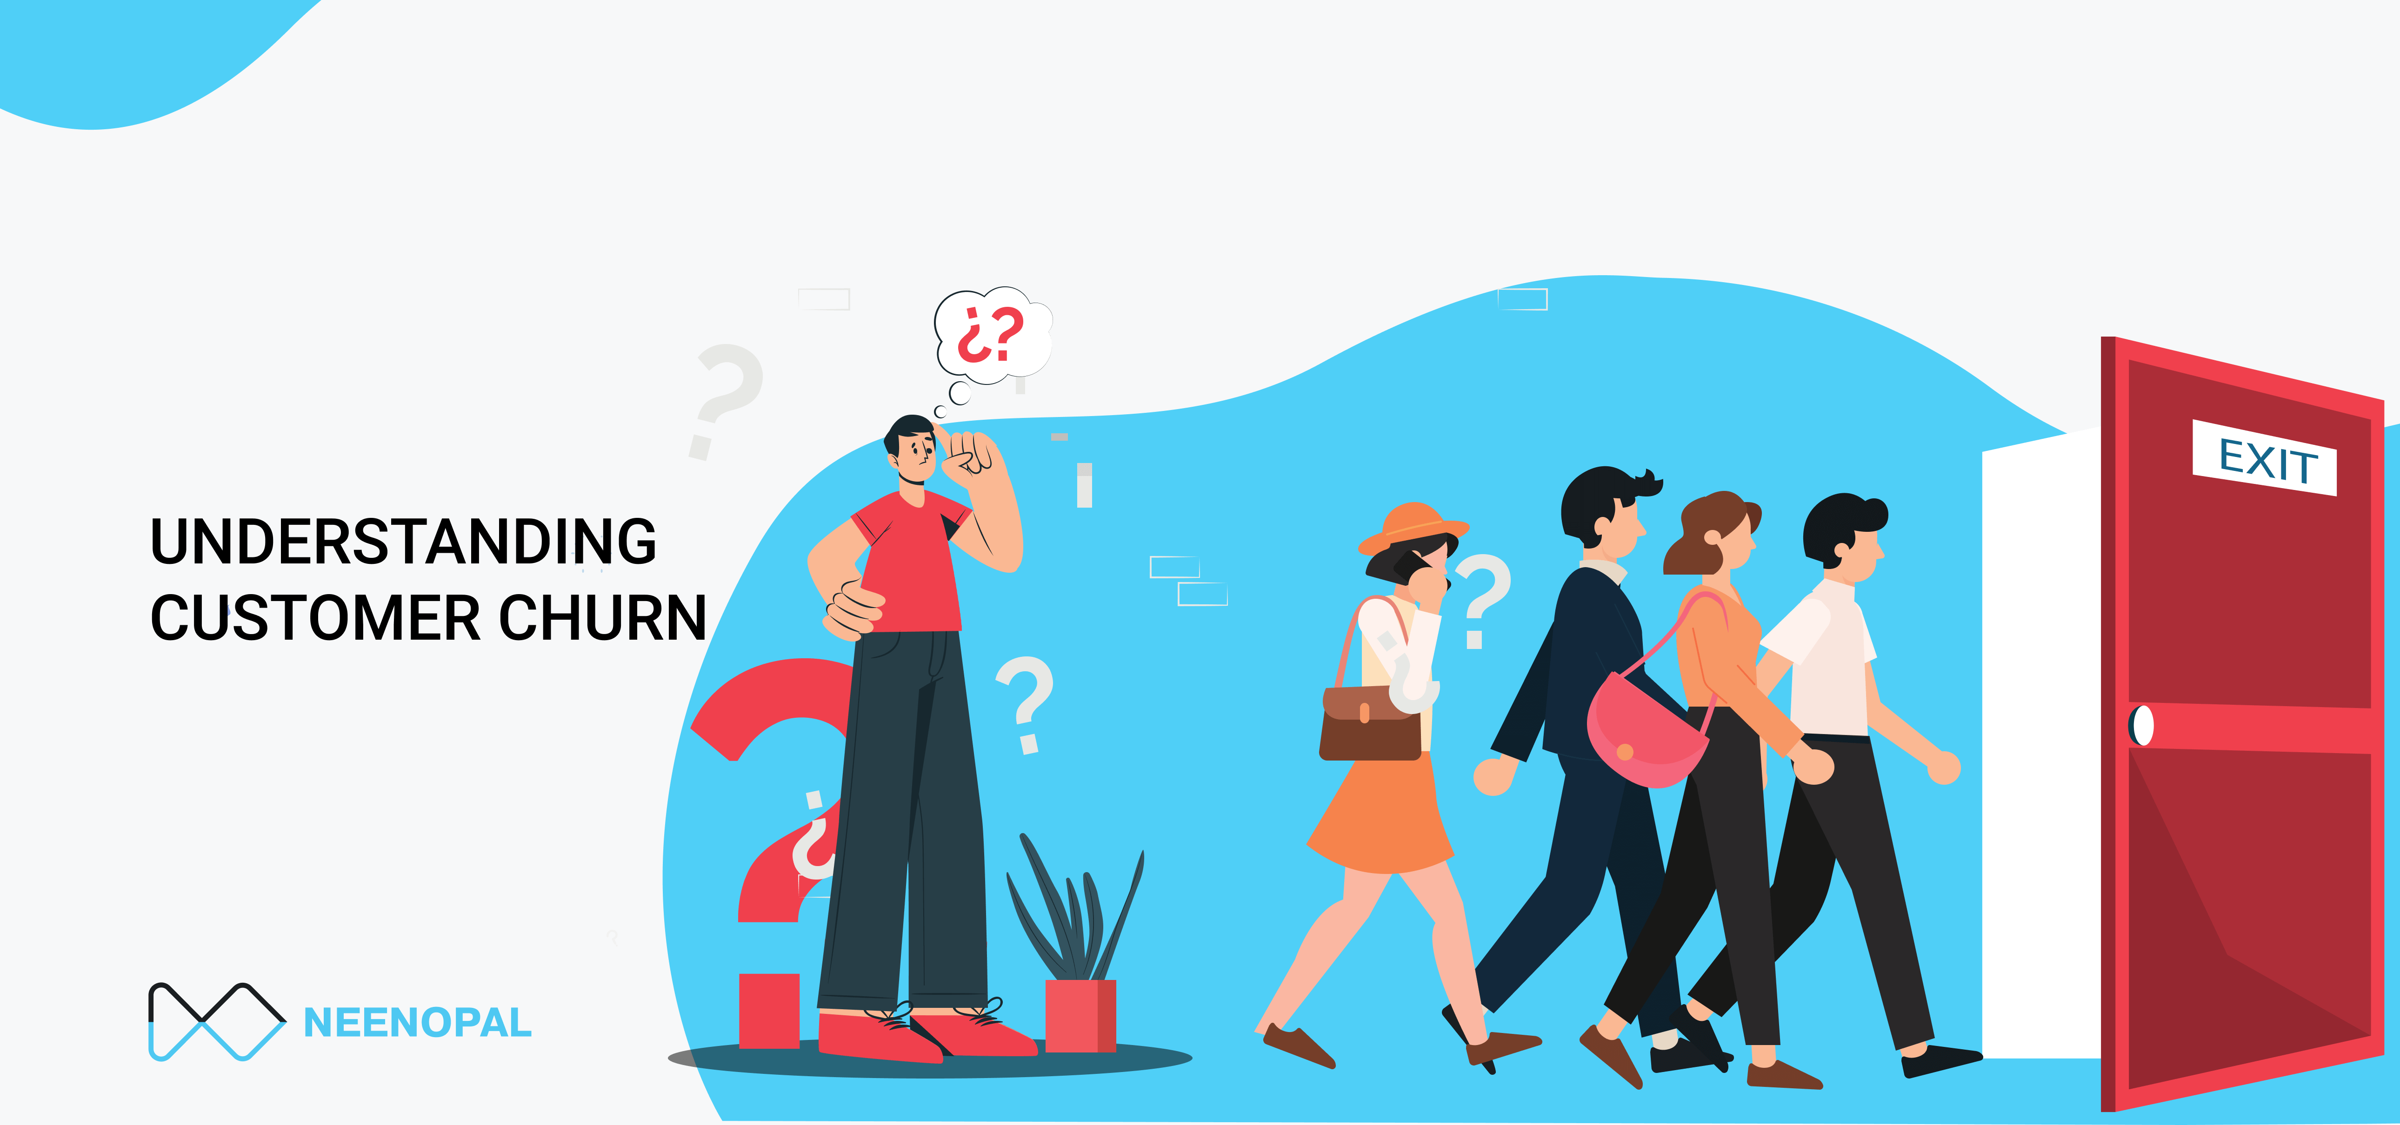
Customer churn analysis
Customer churn is defined as when customers or subscribers discontinue doing business with a firm or service.
Purpose:
Forecast / predict which customers are likely to leave ahead of time.
Focus customer retention efforts only on these "high risk" clients.
The ultimate goal is to expand its coverage area and retrieve more customers loyalty.
Customer churn is a critical metric because it is much less expensive to retain existing customers than it is to acquire new customers

Slide 9
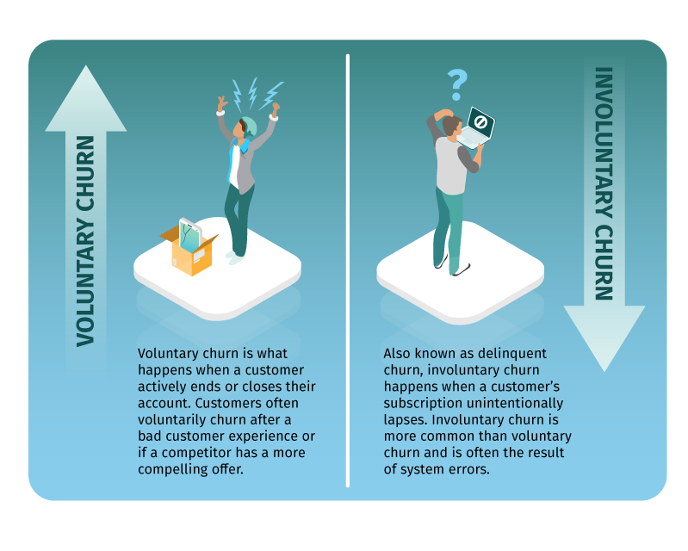
Customer churn analysis
To detect early signs of potential churn, one must first develop a holistic view of the customers and their interactions across numerous channels, including store/branch visits, product purchase histories, customer service calls, Web-based transactions, and social media interactions …
As a result, by addressing churn, these businesses may not only preserve their market position but also grow and thrive.
More customers they have in their network, the lower cost of initiation and the larger the profit. As a result, the company's key focus for success is reducing client attrition and implementing effective retention strategy.

Slide 10
Customer churn analysis
LAB: Customer churn analysis

Slide 11
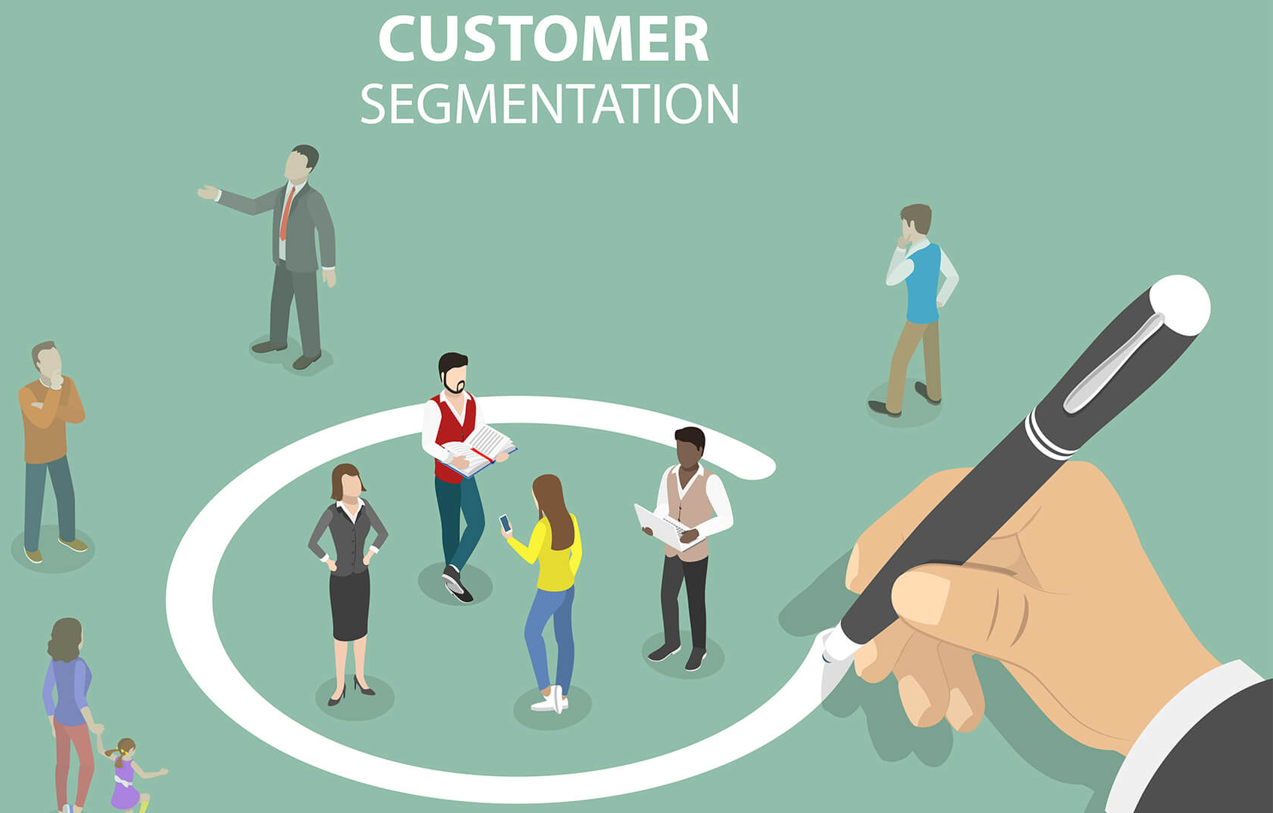
Customer Segmentation
Customer segmentation is a technique used to divide customers into distinct groups based on their behaviour, demographics, preferences, and other characteristics.
Objectives: The objectives of customer segmentation are to:
Identify high-value customers from a large customer base
Understand customer behaviour and preferences
Develop targeted marketing campaigns
Improve customer satisfaction and loyalty
Case studies:
A telecom company used customer segmentation to identify customers who were likely to churn and developed targeted retention campaigns, resulting in a 30% reduction in churn.

Slide 12
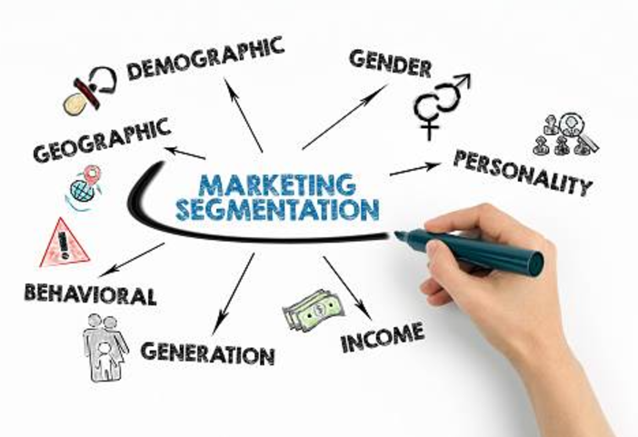
Customer Segmentation
Required datasets:
Customer demographic data (e.g. age, gender, location)
Customer behaviour data (e.g. purchase history, browsing history)
Customer preference data (e.g. product preferences, communication preferences)
Steps:
Collect and clean the data
Identify the variables to use for segmentation (e.g. demographic, behavioral, preference)
Choose a clustering algorithm (e.g. K-Means, Hierarchical Clustering)
Apply the clustering algorithm to the data
Evaluate the clusters and identify the most valuable segments
Develop targeted marketing campaigns for each segment

Slide 13
Customer Segmentation
LAB: Customer Segmentation

Slide 14
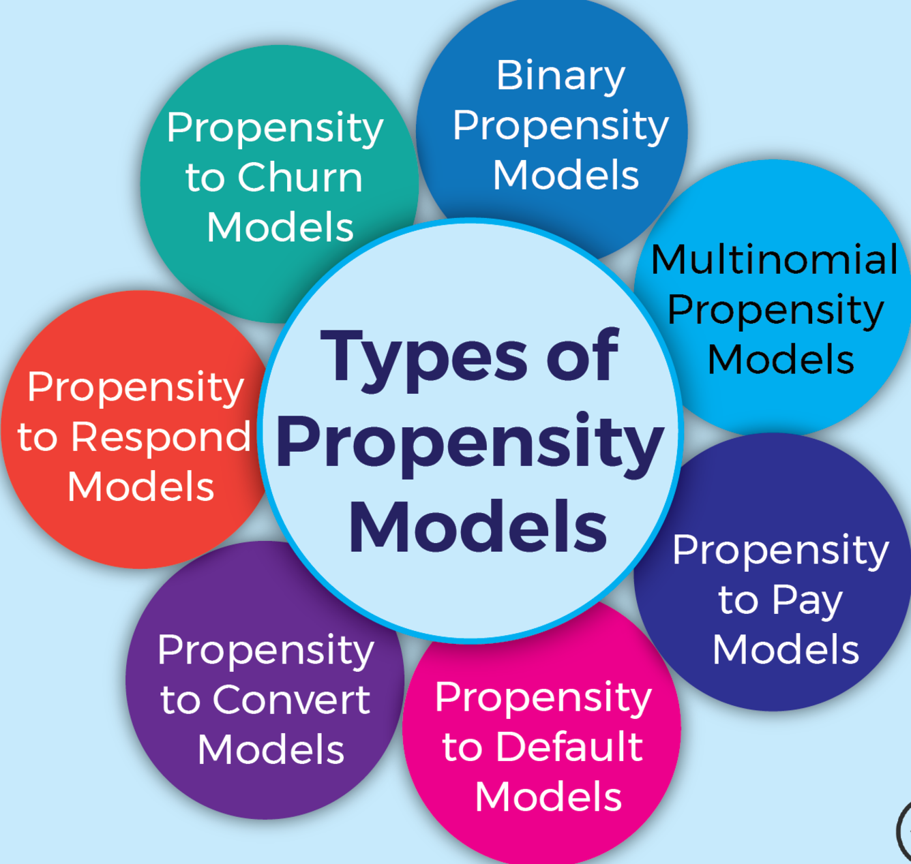
Propensity modelling
Propensity modeling is a technique used to predict the likelihood of a customer to perform a specific action (e.g. make a purchase, respond to an offer, customer lifetime value, propensity to churn).
Objectives: The objectives of propensity model are to:
Identify customers who are likely to perform a specific action
Predict customer behaviour
Develop targeted marketing campaigns
Improve customer conversion rates
Case studies:
A financial services company used propensity modeling to predict which customers were likely to respond to an offer and developed targeted marketing campaigns, resulting in a 30% increase in response rates.

Slide 15
Propensity modelling
Required datasets:
Customer demographic data (e.g. age, gender, location)
Customer behaviour data (e.g. purchase history, browsing history)
Customer preference data (e.g. product preferences, communication preferences)
Historical data on customer actions (e.g. purchases, responses to offers)
Steps:
Collect and clean the data
Identify the variables to use for segmentation (e.g. demographic, behavioural, preference)
Choose a modeling algorithm (e.g. Logistic regression, Decision trees, …)
Apply the modeling algorithm to the data
Evaluate the model and identify the most predictive variables
Use the model to predict customer propensity and develop targeted marketing campaigns.

Slide 16
Propensity modelling
LAB: Propensity Modeling

Slide 17
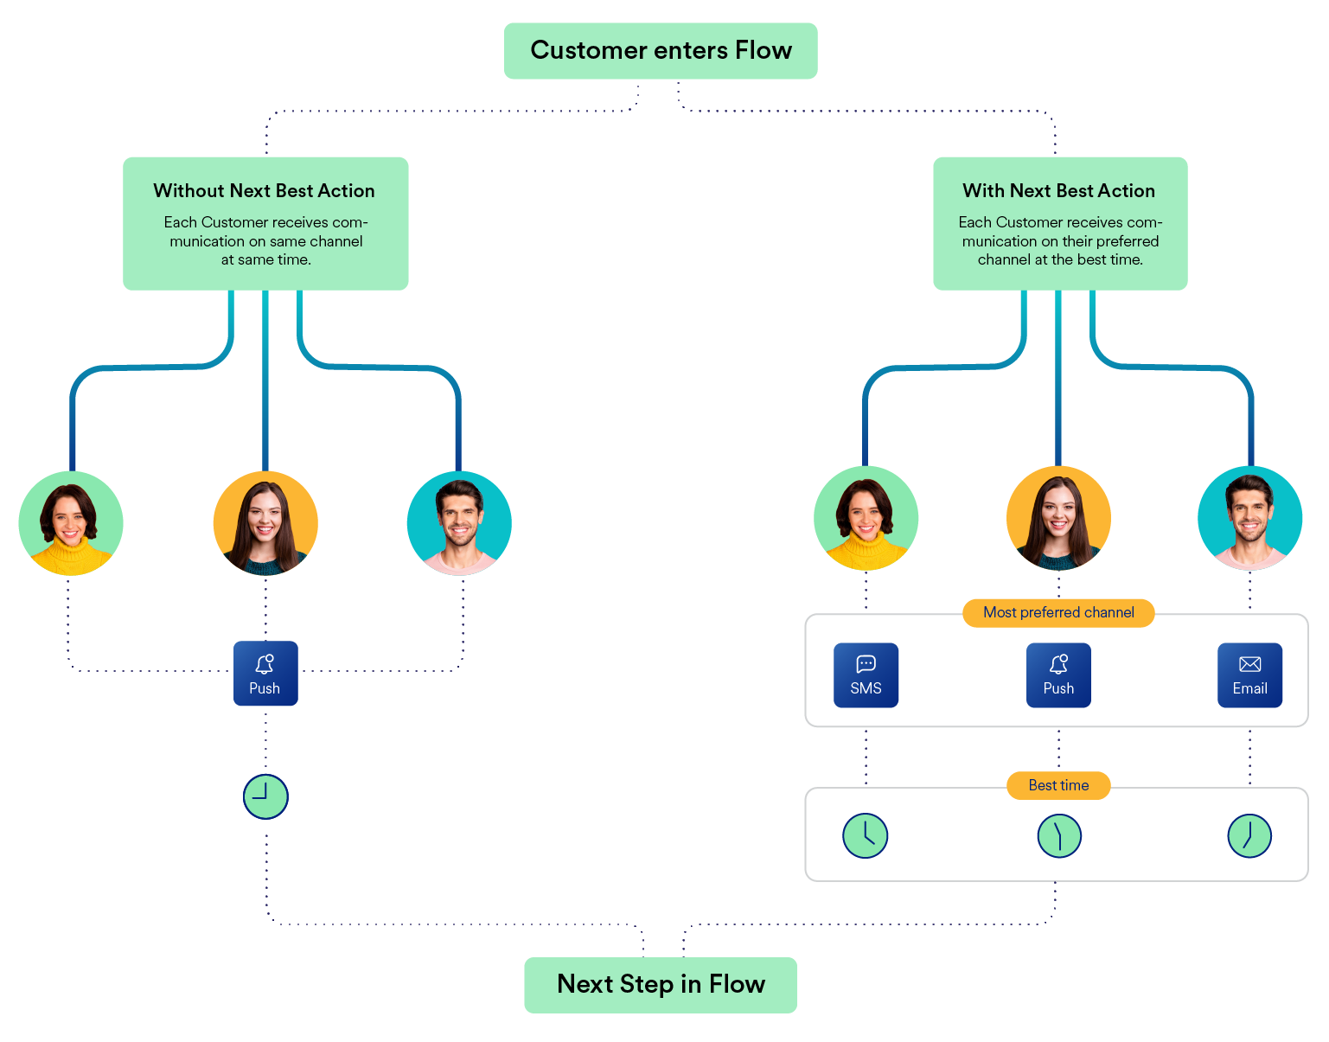
Next best action (nba)
Definition: Next Best Action (NBA) is a technique used to determine the most effective action to take with a customer, based on their past behaviour, preferences, and other factors.
Objectives: The objectives of NBA are to:
Improve customer satisfaction and loyalty
Increase sales and revenue
Enhance customer experience
Case studies:
Company used NBA to determine the most effective channel to send customers marketing information, resulting in a 25% increase in customer satisfaction and a 15% increase in sales.

Slide 18
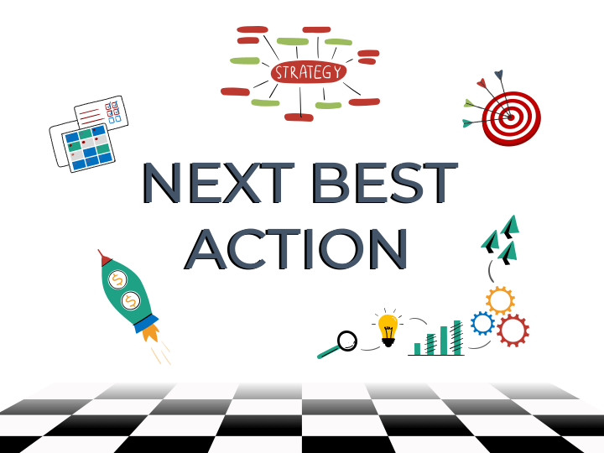
Next best action (nba)
Required datasets:
Customer demographic data (e.g. age, gender, location)
Customer behavior data (e.g. purchase history, browsing history)
Customer preference data (e.g. product preferences, communication preferences)
Customer interaction data (e.g. website interactions, customer service interactions)
Steps:
Collect and clean the data
Identify the variables to use for NBA (e.g. demographic, behavioral, preference)
Choose a machine learning algorithm (e.g. decision trees, random forests)
Train the model using the data
Evaluate the model and identify the most effective actions
Implement the actions and monitor the results

Slide 19
Next best action (nba)
LAB: Next Best Action

Slide 20
Other popular customer analysis
Next Best Offer (NBO): NBO is a technique used to determine the most relevant offer or recommendation for a customer based on their past behavior, preferences, and other factors.
Customer Journey Mapping: This involves analyzing the customer's journey across multiple touchpoints and channels to identify pain points, opportunities, and areas for improvement.
Sentiment Analysis: Sentiment analysis involves analyzing customer feedback, reviews, and social media posts to understand their emotions and opinions about a product or service.
Predictive Maintenance: Predictive maintenance involves using machine learning algorithms to predict when a customer is likely to experience a problem or issue with a product or service.
Personalization: Personalization involves using AI/ML to create tailored experiences for customers based on their behavior, preferences, and other characteristics.
Customer Lifetime Value (CLV): CLV involves analyzing the total value of a customer over their lifetime, including their past purchases, future potential, and other factors.
Customer Health Score: Customer health score involves analyzing various metrics, such as engagement, satisfaction, and loyalty, to determine the overall health of a customer relationship.

